Slide 1
APPROCCIO FARMACOLOGICO: INDICAZIONI E LIMITI
LUCA BUSETTO
Dipartimento di medicina
Universita’ di padova

Slide 2
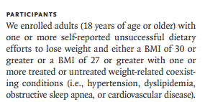
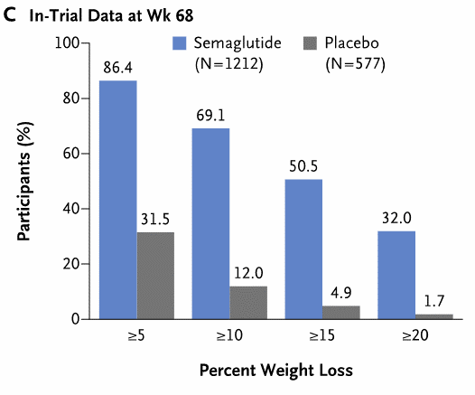
Wilding JPH et al. NEJM 2021;384:989

Slide 3
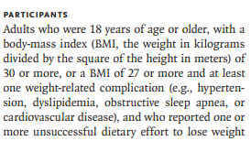
Jastreboff AM et al. N Engl J Med 2022;387:205

Slide 4

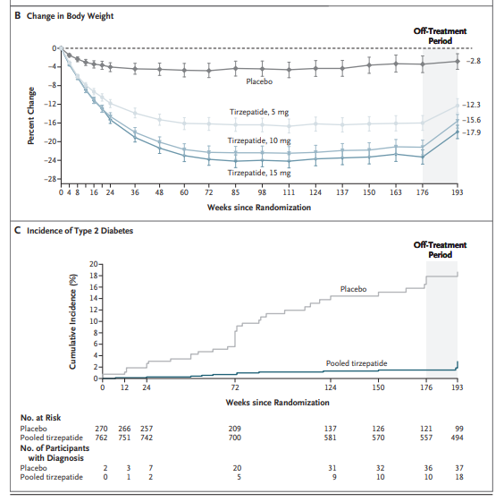
Jastreboff AM et al. N Engl J Med 2024; Nov 13

Slide 6

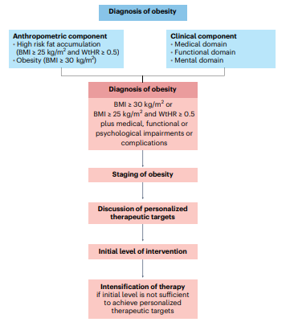

Busetto L et al. Nat Med 2024;30:2395-2399.

Slide 7
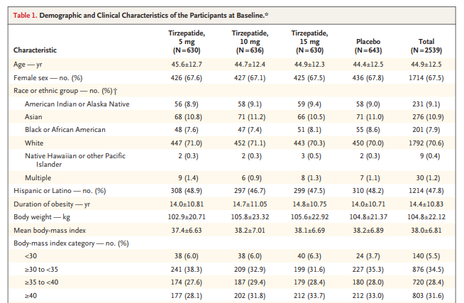
Jastreboff AM et al. N Engl J Med 2022;387:205

Slide 8

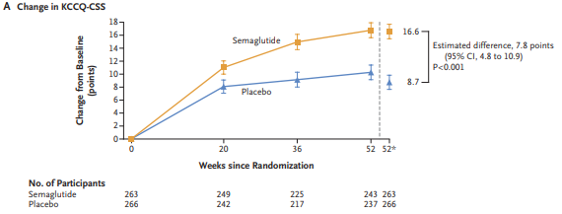
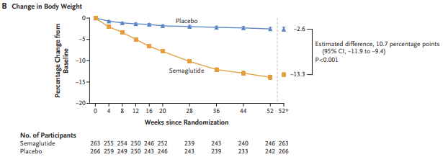
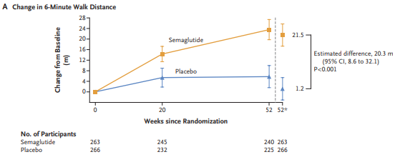
Kosiborod MN et al. NEJM 2023;389:1069

Slide 9

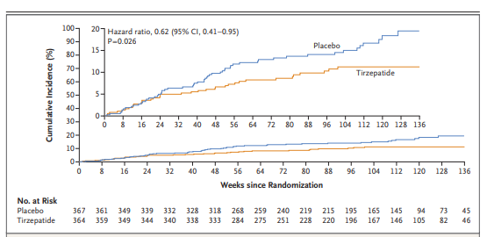
Packer M et al. NEJM 2024 Nov 16.

Slide 10
MACE:
701 on 8801 pts (8.0%) in placebo
569 on 8803 pts (6.5%) in semaglutide
ABR: 1.5%
NNT: 67
Lincof AM et al. N Engl J Med. 2023;389:2221.

Slide 11

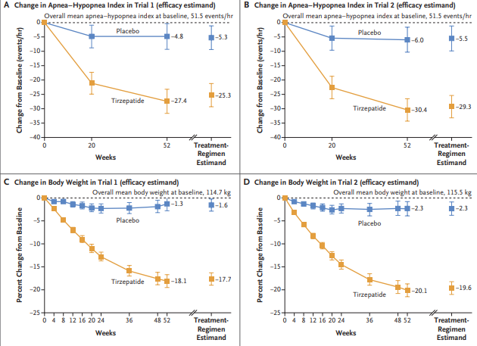
Malhotra A et al. NEJM 2024;391:1193

Slide 12
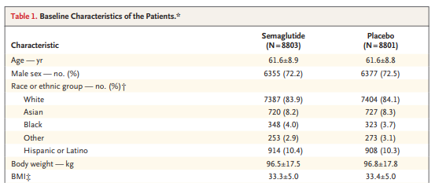
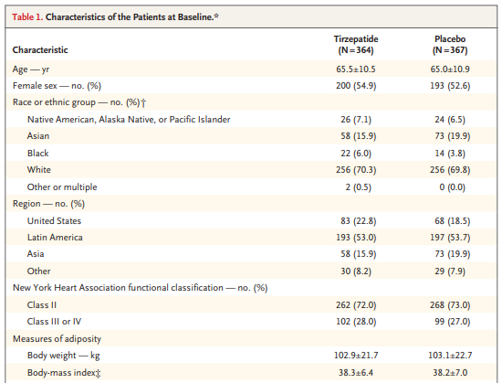
Lincof AM et al. N Engl J Med. 2023;389:2221.
Packer M et al. NEJM 2024 Nov 16.

Slide 13
Jastreboff AM et al. N Engl J Med 2022;387:205

Slide 14
Jastreboff AM et al. N Engl J Med 2022;387:205

Slide 15
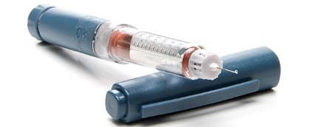



Invasivity/Risk/Cost
10
20
30
%WL

Slide 16
A significant proportion of patients do will not achieve the target with obesity management medications
Jastreboff AM et al. N Engl J Med 2022;387:205

Slide 17

%WL AS A DISTANCE TO TARGET
Patients with height 174 cm, BMI target 26 kg/m² (corresponding to a BW of 80.0 kg) and different baseline body weight / BMI.
WL 6%
85,0 kg / BMI 28,1 kg/m²
WL 16%
95,0 kg / BMI 31,4 kg/m²
105,0 kg / BMI 34,7 kg/m²
WL 24%
WL 30%
115,0 kg / BMI 38,0 kg/m²
WL 36%
125,0 kg / BMI 41,3 kg/m²
135,0 kg / BMI 44,6 kg/m²
WL 41%

Slide 18
If we agree on individualised BMI or WHtR target, do we should propose as initial level of intervention a therapeutic modality with a reasonable chance to achive the BMI or WHtR target?
Patient with height 174 cm and BMI target 26 kg/m² (corresponding to a BW of 80.0 kg)
Initial BW Initial BW Requested % weight loss
85.0 kg 28.1 kg/m² 6%
95.0 kg 31.4 kg/m² 16%
105.0 kg 34.7 kg/m² 24%
115.0 kg 38.0 kg/m² 30%
125.0 kg 41.3 kg/m² 36%
135.0 kg 44.6 kg/m² 41%

Slide 19

Will new pharmacological treatment for obesity and early diabetes replace bariatric surgery?
Lingway I et al. Lancet Diabetes Endocrinol 2023;11:541

Slide 20
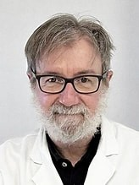



Grazie
Grazie per
l’attenzione !!!
luca.busetto@unipd.it
Luca Busetto
@busetto_luca

